Slide 1



COMP5523
Group Project Introduction
Feb 24, 2026
Notes:
i will give an introduction of the group project.

Slide 2
00 Outline
Group Project Specification
Group Presentation
Feedback System
Notes:
it includes three parts

Slide 3





01 Group Project Specification
Topic: Interactive Vision-Assisted Object Grasping for the Visually Impaired
Develop a system to help visually impaired people safely and efficiently pick up a specific target object​ in daily life.
The object selection is not limited, choose whatever common objects in daily life
headphone
apple
shoes
target object
Notes:
firstly, i gonna introduce the project specification.
In this semester, the topic is xxx
It aims to develop xxx
For example, this is a blind person, and the target object is an apple; the system should guide his hand to approach the target and help him grasp the apple through audio guidance and interaction.

Slide 4


01 Group Project Specification
Core Idea & Relevant techniques
Track the user’s hand position
object detection
hand tracking
Track the target object’s position
object detection
Spatial understanding
Spatial relative distance measuring (hand <--> object)
Real-time audio guidance and interaction
ASR, TTS
move right
move down
move down
Notes:
To implement such a system, it usually involves the following techniques.
Firstly, the object detection is used to identify user’s hand and the target object.
Other than the object dection, the system should be aware of the hand’s and target object’s position.
Thus, hand tracking and spatial understanding are two helpful techniques.
and then, the system should also provide audio guidance and interaction, the ASR and TTS are ttwo important techniques to achieve this.
ASR means Automatic Speech Recognition: it is a technique to convert the audio into text. It is more convenient to analyze user’s need from text than from audio.
Conversely， TTS means text to speech, aims to convert the text into speech.

Slide 5
01 Group Project Specification
Project Steps
Data preparation: datasets for objects, hand pose, reaching/grasping videos
Algorithm design: compare detection + tracking; spatial relation understanding; define guidance strategy
System implementation: real-time pipeline + user-friendly audio interface
Evaluation: success rate, guidance accuracy, time-to-grasp, latency, failures
Notes:
A comprehensive group project usually include 4 parts.
Data preparation [prepəˈrāSH(ə)n]: Collect or curate high-quality training datasets to enhance the performance of specific models such as object detection or hand tracking models. Also collect test set for evaluation
Algorithm design: Compare different state-of-the-art models and select the most appropriate one for project use. If time is sufficient, we can also do some model archtecture designing and exploring to make models more effective and efficient.
System implementation: Once we determined what models to use, we then ntegrate the selected models into the system. Deliver a real-time, user-friendly interface that provides smooth audio guidance and interaction.
Last but not least, evaluation. The evaluation part is often overlooked in past group projects, however, it is crucial for rigorously assessing system performance and demonstrating the effectiveness of your system. The widely used metrics for this project is grasping success rate, guidance accuracy, and so on.
Please do not neglect this part—your project score will be deducted accordingly if this part is missing.

Slide 6
01 Group Project Specification
Example Video
Notes:
To help you better understand the project, here we provide an example video. This video is from the AI-Care Project, which is led by Prof. Li.
[playing video]
In this video, our lab member mimics a blind person by wearing an eye mask, and he also wears smart glasses.
The smart glasses integrate our smart system. One of the functions of the system is to provide real-time audio guidance and interactions to help the user grasp objects.
Basically, it is similar to the group project of this semester.
Ofc it is still not perfect, there is still room for you to make it better and better.
This is just an example video. In the group project, you don’t need to deploy your system into smart glasses as the video does; you can deploy it into your PC or smartphone for convenience.

Slide 7
01 Group Project Specification
Difference between Last Semester's Project and This Semester's
Last semester: more general; focused on general scene understanding, e.g.,
Obstacle detection: Detect objects in front of visually impaired users and alert them when obstacles are found
OCR (Optical Character Recognition): Read and convey text content from images to visually impaired users
Scene Description: provide comprehensive descriptions of the surrounding environment to visually impaired users
This semester: more task-specific; focuses on guiding users to pick up objects through real-time audio guidance (e.g., "move left", "closer", "open hand").
Notes:
Considering that some students may want to refer to last semester’s project. Here, we would like to clarify that they are different.
Last semester’s project is more general....
However, this semester’s ...
Interaction between the user and system is more important for this semester’s project. Properly guidance and effective interaction could increase the grasping success rate.
---
Okay, this is the difference between last project and this project.
Any questions about the specification so far?

Slide 8
02 Group Project Presentation
Presentation Date
The group project presentation will happen on 🗓 April 14th
Each group has 7 minutes to showcase your project and do live demonstration, and there is no a Q&A session.
Notes:
Lets move to the next part -- Presentation
the presentation will happen on April fourteenth.
It is important to know that each group has only 7 minutes to showcase your project and do live demonstration, and no Q&A session.
The time is different from the specification document where 10 minutes are listed. Here, we only give each group 7 minutes.
Considering we have 23 groups, 10 minutes each group will exceed the available class duration.
So remove the Q&A section to make it more efficient.

Slide 9
02 Group Project Presentation
Presentation Order
Will be released before presentation
Notes:
The group registration is still finalizing, thus, the presentation order is not ready yet. We will release it before presentation.

Slide 10
02 Group Project Presentation
Presentation Process
Presenter(s) join the zoom meeting in advance; share screen when start presenting; strictly control the time within 7mins Please install Zoom, sign in with your PolyU account, grant screen-sharing and voice permission in advance.
The professor and TAs will evaluate and score during the presentation.
Students from other groups will provide feedback via an online feedback system.
Students who submit constructive feedback that is endorsed by the presenting group will earn maximum 1 bonus point , which will count toward the final score (0-100 scale)
After finishing the presentation, presenting group should review the feedback online and endorse helpful comments.
Notes:
To make it smooth, please install zoom, sign in with ...
final score is range from 0 to 100.
Maximum 1 point per student can be earned, even if multiple feedback submissions are endorsed. Ofc, providing more feedback to more groups can increase your chances of receiving an endorsement.

Slide 11
02 Group Project Presentation
Tips for a successful presentation
Given the limited time (7 minutes):
Please ensure your equipment and environment are properly set up.
Please don't let your laptop die; 🔋 fully charge it before presenting.
Please configure Zoom in advance
install Zoom
sign in with your PolyU account
grant screen-sharing and voice permission
Practice beforehand and keep your presentation within 7 minutes.
Notes:
Here are some Tips

Slide 12
02 Group Project Presentation
Scoring Rubics
1) Appropriateness.
Task settings, challenges, methodologies, and system functionality are highly appropriate and relevant. (3%)
Task settings, challenges, methodologies, and system functionality are mostly appropriate and relevant. (2.5%)
Task settings, challenges, methodologies, and system functionality demonstrate some level of appropriateness. (2%)
Task settings, challenges, methodologies, and system functionality are inadequate. (1.5%)
Task settings, challenges, methodologies, and system functionality are inappropriate. (1%)
Notes:
Next, I will introduce the scoring rubrics.
There are 5 evaluation items, each with 5 levels.
The score weight for the level 1 is 3 percent, level 2 is 2.5%, level 3 is 2%, level 4 is 1.5%, level 5 is 1%
The first evaluation item is **Appropriateness**, which assesses the task settings, challenges, methodologies, and system functionality.
To achieve a higher score, ensure that your task settings, challenges, methodologies, and system functionality are appropriate and relevant to the project topic and requirements.

Slide 13
02 Group Project Presentation
Scoring Rubics
2) Soundness.
The project demonstrates a comprehensive and well-organized development process with clear and logical explanations. (3%)
The project demonstrates a mostly comprehensive and well-organized development process with mostly clear and logical explanations. (2.5%)
The project demonstrates some level of organization and logic in the development process, but with some unclear explanations. (2%)
The project demonstrates limited organization and logic in the development process and provides inadequate explanations. (1.5%)
The project is disorganized and lacks a clear or logical development process with unclear or illogical explanations. (1%)
Notes:
The second evaluation item is soundness, it evaluates whether the project is comprehensive and well-organized. To achieve a higher score, make ensure that you operate a comprehensive and well-organized development process with clear and logical explanations.

Slide 14
02 Group Project Presentation
Scoring Rubics
3) Excitement.
The project presents innovative and engaging ideas that consistently capture the attention of the audience. (3%)
The project presents engaging ideas that mostly capture the attention of the audience, but may lack consistency. (2.5%)
The project presents some level of engagement, but with areas of improvement and inconsistent audience attention. (2%)
The project lacks innovation and fails to capture the audience's excitement consistently. (1.5%)
The project lacks excitement or fails to engage the audience. (1%)
Notes:
Excitement eveluates the novelty of the project. If your project presents innovative and engaging ideas, you will get higher scores.

Slide 15
02 Group Project Presentation
Scoring Rubics
4) Presentation.
The presentation is highly polished and professional, with excellent delivery and effective use of visual aids. (3%)
The presentation is mostly polished and professional, with good delivery and adequate use of visual aids. (2.5%)
The presentation has some areas of improvement in polish and professionalism, and delivery may lack consistency. (2%)
The presentation lacks polish and professionalism, and delivery is weak. Visual aids are ineffective. (1.5%)
The presentation is poorly executed, making it difficult to follow, with ineffective use of visual aids. (1%)
Notes:
Presentation evaluates the performance of your presentation. If your presentation is highly professional, and can make good use of visual aids, you will get higher scores.

Slide 16
02 Group Project Presentation
Scoring Rubics
5) Writting.
The project report is well-written, with clear and concise explanations of ideas and proper use of grammar and formatting. (3%)
The project report is mostly well-written, with mostly clear and concise explanations of ideas and mostly proper use of grammar and formatting. (2.5%)
The project report is adequately written, with some clarity issues and inconsistent use of grammar and formatting. (2%)
The project report is poorly written, with unclear or confusing explanations and significant errors in grammar and formatting. (1.5%)
The project report is very poorly written, with numerous clarity and formatting errors, making it difficult to understand. (1%)
Notes:
During the presentation, we only score the first 4 items, and the last item, writting , will be scored after you submit your report. To achieve a higher writting score, ensure your project report is well-written, with clear and concise explanations of ideas and proper use of grammar and formatting.
---
Any questions so far about the presentation part?

Slide 17
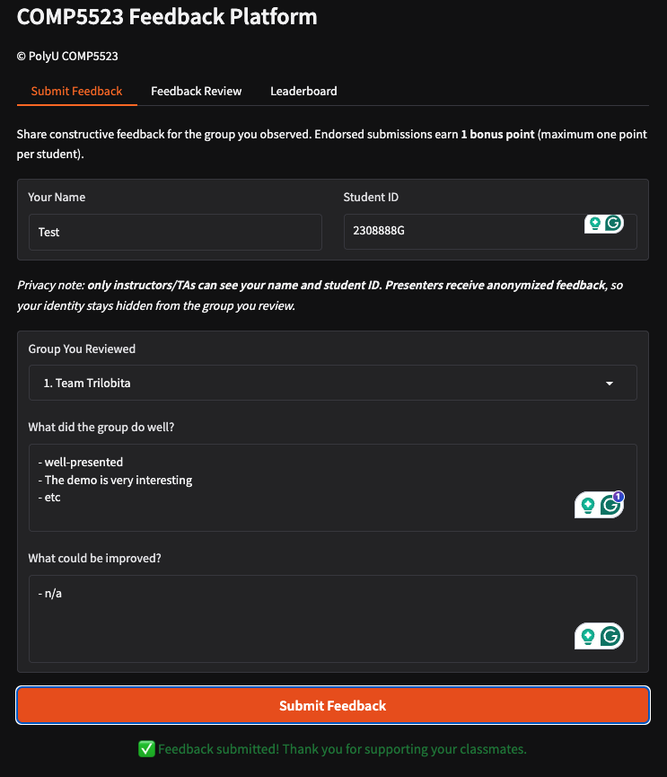
03 Online Feedback System
1
How to submit feedback
2
1
Click [Submit Feeback] at the top bar
2
Fill your name and student ID, both are required
[Only visible to you and the teaching team; anonymous to other students]
3
3
Select a target group
4
4
Fill [What did the group do well]
5
Fill [What could be improved]
5
6
Click [Submit Feedback] Button
6
7
Status message
7
Notes:
The final part is the online feedback system. It is used to submit and endorse feedback during presentation.
We will make the system online before presentation, so you can test it then.
Here shows the steps to submit feedback.
First, click [submit feedback] button at the top bar
Then, fill you name and student id, they are required. No worries, your information is only visible to you and the teaching team; it is anonymous to other students.
Next, select a target group
After that, write down your feedback.
Click the [Submit Feedback] button to send your feedback.

Slide 18
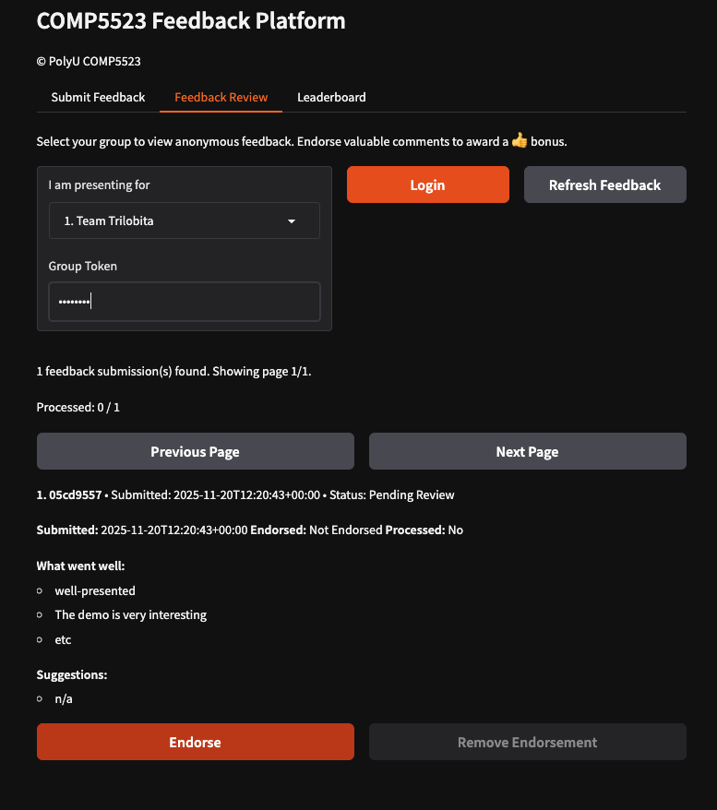
03 Online Feedback System
1
How to review feedback
2
8
1
Click [Feeback Review] at the top bar
3
2
Select your group
3
Input your group token [Don’t disclose it]
4
5
4
Check progress [endorsed/submitted]
5
Return to previous page or move to next page
6
Endorse feedback
7
Remove endorsement
6
7
8
Refresh feedback to show latest feedback (if have)
Notes:
Here shows the steps to review feedback.
First, click the [feedback review] button at the top bar
Then, select your group, and enter your group token (this will be sent to each group member before the presentation; each group has a unique token—please keep it confidential within your group)
Once logged in the system, you can perform endorsement there.

Slide 19
Best of luck with your group project!
Notes:
That is all.
Thank you
Questions?

